Slide 1
DeepSeek-R1: Incentivizing Reasoning Capability in LLMs via Reinforcement Learning
Presented by: Natnael Daba
Feb 18, 2025

Slide 2
Authors
DeepSeek-AI, Daya Guo, Dejian Yang, Haowei Zhang, Junxiao Song, Ruoyu Zhang, Runxin Xu, Qihao Zhu, Shirong Ma, Peiyi Wang, Xiao Bi, Xiaokang Zhang, Xingkai Yu, Yu Wu, Z.F. Wu, Zhibin Gou, Zhihong Shao, Zhuoshu Li, Ziyi Gao, Aixin Liu, Bing Xue, Bingxuan Wang, Bochao Wu, Bei Feng, Chengda Lu, Chenggang Zhao, Chengqi Deng, Chenyu Zhang, Chong Ruan, Damai Dai, Deli Chen, Dongjie Ji, Erhang Li, Fangyun Lin, Fucong Dai, Fuli Luo, Guangbo Hao, Guanting Chen, Guowei Li, H. Zhang, Han Bao, Hanwei Xu, Haocheng Wang, Honghui Ding, Huajian Xin, Huazuo Gao, Hui Qu, Hui Li, Jianzhong Guo, Jiashi Li, Jiawei Wang, Jingchang Chen, Jingyang Yuan, Junjie Qiu, Junlong Li, J.L. Cai, Jiaqi Ni, Jian Liang, Jin Chen, Kai Dong, Kai Hu, Kaige Gao, Kang Guan, Kexin Huang, Kuai Yu, Lean Wang, Lecong Zhang, Liang Zhao, Litong Wang, Liyue Zhang, Lei Xu, Leyi Xia, Mingchuan Zhang, Minghua Zhang, Minghui Tang, Meng Li, Miaojun Wang, Mingming Li, Ning Tian, Panpan Huang, Peng Zhang, Qiancheng Wang, Qinyu Chen, Qiushi Du, Ruiqi Ge, Ruisong Zhang, Ruizhe Pan, Runji Wang, R.J. Chen, R.L. Jin, Ruyi Chen, Shanghao Lu, Shangyan Zhou, Shanhuang Chen, Shengfeng Ye, Shiyu Wang, Shuiping Yu, Shunfeng Zhou, Shuting Pan, S.S. Li , Shuang Zhou, Shaoqing Wu, Shengfeng Ye, Tao Yun, Tian Pei, Tianyu Sun, T. Wang, Wangding Zeng, Wanjia Zhao, Wen Liu, Wenfeng Liang, Wenjun Gao, Wenqin Yu, Wentao Zhang, W.L. Xiao, Wei An, Xiaodong Liu, Xiaohan Wang, Xiaokang Chen, Xiaotao Nie, Xin Cheng, Xin Liu, Xin Xie, Xingchao Liu, Xinyu Yang, Xinyuan Li, Xuecheng Su, Xuheng Lin, X.Q. Li, Xiangyue Jin, Xiaojin Shen, Xiaosha Chen, Xiaowen Sun, Xiaoxiang Wang, Xinnan Song, Xinyi Zhou, Xianzu Wang, Xinxia Shan, Y.K. Li, Y.Q. Wang, Y.X. Wei, Yang Zhang, Yanhong Xu, Yao Li, Yao Zhao, Yaofeng Sun, Yaohui Wang, Yi Yu, Yichao Zhang, Yifan Shi, Yiliang Xiong, Ying He, Yishi Piao, Yisong Wang, Yixuan Tan, Yiyang Ma, Yiyuan Liu, Yongqiang Guo, Yuan Ou, Yuduan Wang, Yue Gong, Yuheng Zou, Yujia He, Yunfan Xiong, Yuxiang Luo, Yuxiang You, Yuxuan Liu, Yuyang Zhou, Y.X. Zhu, Yanhong Xu, Yanping Huang, Yaohui Li, Yi Zheng, Yuchen Zhu, Yunxian Ma, Ying Tang, Yukun Zha, Yuting Yan, Z.Z. Ren, Zehui Ren, Zhangli Sha, Zhe Fu, Zhean Xu, Zhenda Xie, Zhengyan Zhang, Zhewen Hao, Zhicheng Ma, Zhigang Yan, Zhiyu Wu, Zihui Gu, Zijia Zhu, Zijun Liu, Zilin Li, Ziwei Xie, Ziyang Song, Zizheng Pan, Zhen Huang, Zhipeng Xu, Zhongyu Zhang, Zhen Zhang
DeepSeek-AI
research@deepseek.com

Slide 3
Content
Introduction
Contributions
Deepseek-R1-Zero: RL on the Base Model
Deepseek-R1: Reinforcement Learning with Cold Start
Distillation: Empower Small Models with Reasoning Capability
Deepseek-R1 Evaluation
Distilled Model Evaluation
Distillation v.s. Reinforcement Learning
Resources

Slide 4
Introduction
Goal: explore the potential of LLMs to develop reasoning capabilities using pure reinforcement learning (RL) process.
Use DeepSeek-V3-Base¹ as the base model and Group Relative Policy Optimization (GRPO) as RL framework.
This results in DeepSeek-R1-Zero.
However, DeepSeek-R1-Zero encounters challenges such as poor readability, and language mixing.
¹Liu, Aixin, et al. "Deepseek-v3 technical report." arXiv preprint arXiv:2412.19437 (2024).

Slide 5
Introduction
DeepSeek-R1 was introduced to address shortcomings of DeepSeek-R1-Zero.
DeepSeek-R1 incorporates a small amount of cold-start data and a multi-stage training pipeline.
Explored distillation from DeepSeek-R1 to smaller dense models.
Demonstrated that the reasoning patterns discovered by larger base models are crucial for improving reasoning capabilities.
¹Qwen. Qwen2.5: A party of foundation models, 2024b. URL https://qwenlm.github.io/blog/qwen2.5

Slide 6
Contributions
Post-Training: Large-Scale Reinforcement Learning on the Base Model
Applied RL to a base model without relying on supervised fine-tuning (SFT) as a preliminary step.
Validated that reasoning capabilities of LLMs can be incentivized purely through RL, without SFT.
Introduced a pipeline for combining multiple RL and SFT stages to discover improved reasoning patterns.

Slide 7
Contributions
Distillation: Smaller Models Can Be Powerful Too
Demonstrated that the reasoning patterns of larger models can be distilled into smaller models.
Validated that this results in better performance compared to the reasoning patterns discovered through RL on small models.

Slide 8
DeepSeek-R1-Zero: RL on the Base Model
Reinforcement Learning Algorithm
Group Relative Policy Optimization (GRPO)
Reward Modeling
Accuracy rewards
Format rewards
Training Template
Performance, Self-evolution Process and Aha Moment of DeepSeek-R1-Zero
Drawback of DeepSeek-R1-Zero

Slide 9
DeepSeek-R1-Zero: RL on the Base Model
Reinforcement Learning Algorithm
Group Relative Policy Optimization (GRPO)
Reward Modeling
Accuracy rewards
Format rewards
Training Template
Performance, Self-evolution Process and Aha Moment of DeepSeek-R1-Zero
Drawback of DeepSeek-R1-Zero

Slide 10
Reinforcement Learning Algorithm
Group Relative Policy Optimization (GRPO)¹
RL algorithm used to train DeepSeek-R1-Zero
Foregoes the critic model that is typically the same size as the policy model.
Estimates the baseline from group scores instead.
¹Shao, Zhihong, et al. "Deepseekmath: Pushing the limits of mathematical reasoning in open language models." arXiv preprint arXiv:2402.03300 (2024).

Slide 11

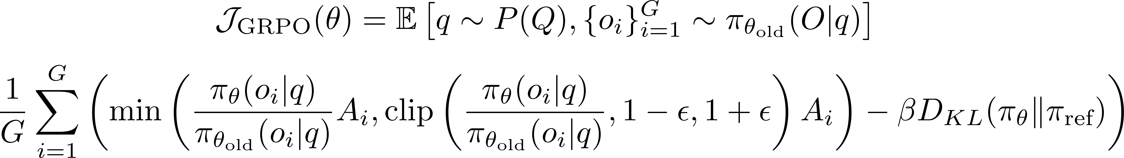
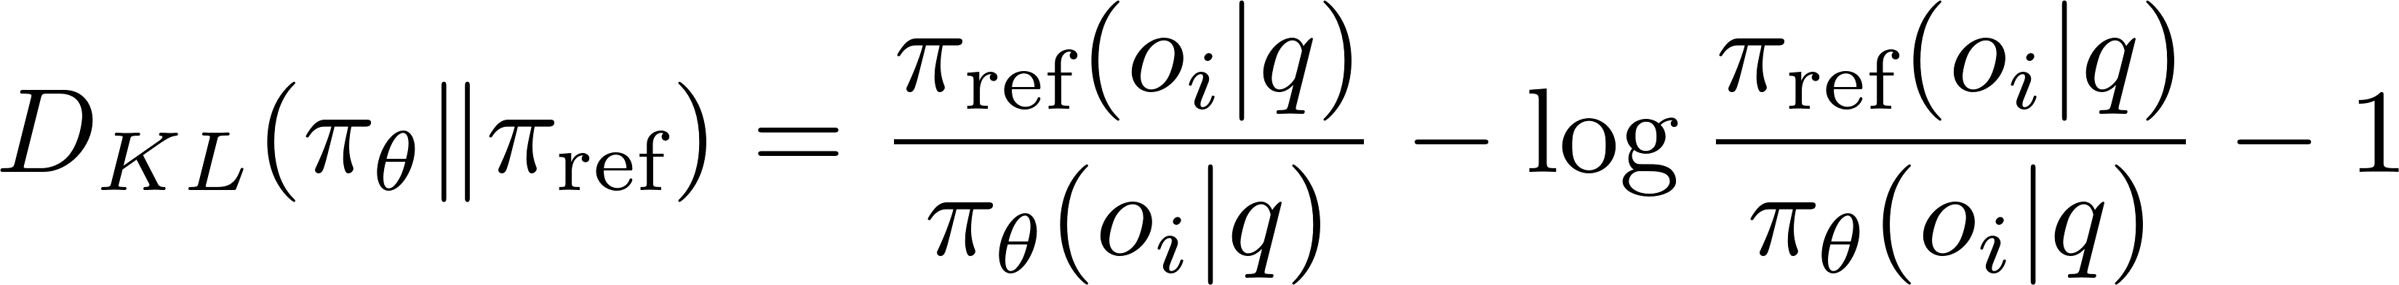
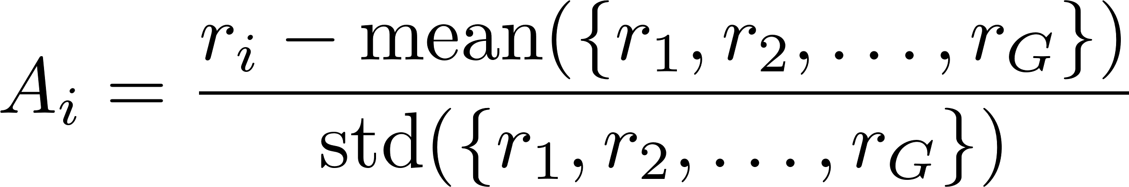
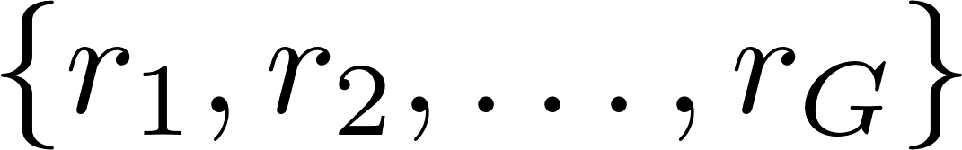
Reinforcement Learning Algorithm
Group Relative Policy Optimization (GRPO)¹: optimize the policy model by maximizing the following objective:
Advantage computed using a group of rewards
¹Shao, Zhihong, et al. "Deepseekmath: Pushing the limits of mathematical reasoning in open language models." arXiv preprint arXiv:2402.03300 (2024).
Notes:
1. \mathbb{E}{q,\{o_i\} \sim \pi{\theta_{\mathrm{old}}}}
“Take the expected value over prompts q and the group of outputs \{o_i\} sampled from the old policy.”
2. \frac{1}{G}\sum_{i=1}^G
“Average across the G outputs in each sampled group.”
3. \frac{\pi_{\theta}(o_i \mid q)}{\pi_{\theta_{\mathrm{old}}}(o_i \mid q)}
“The policy ratio: how much more (or less) likely output o_i is under the new policy vs. the old one.”
4. A_i
“The advantage: how much better or worse each output’s reward is compared to the group’s average.”
5. \min\bigl(\dots,\;\text{clip}(\dots)\bigr)
“PPO‐style clipping that prevents overly large changes in the policy ratio to stabilize training.”
6. \beta
“A hyperparameter scaling how strongly we penalize the policy for drifting from a reference.”
7. D_{\mathrm{KL}}\bigl(\pi_{\theta}\,\big\|\,\pi_{\mathrm{ref}}\bigr)
“A KL‐divergence term keeping the new policy close to a chosen reference policy.”

Slide 12
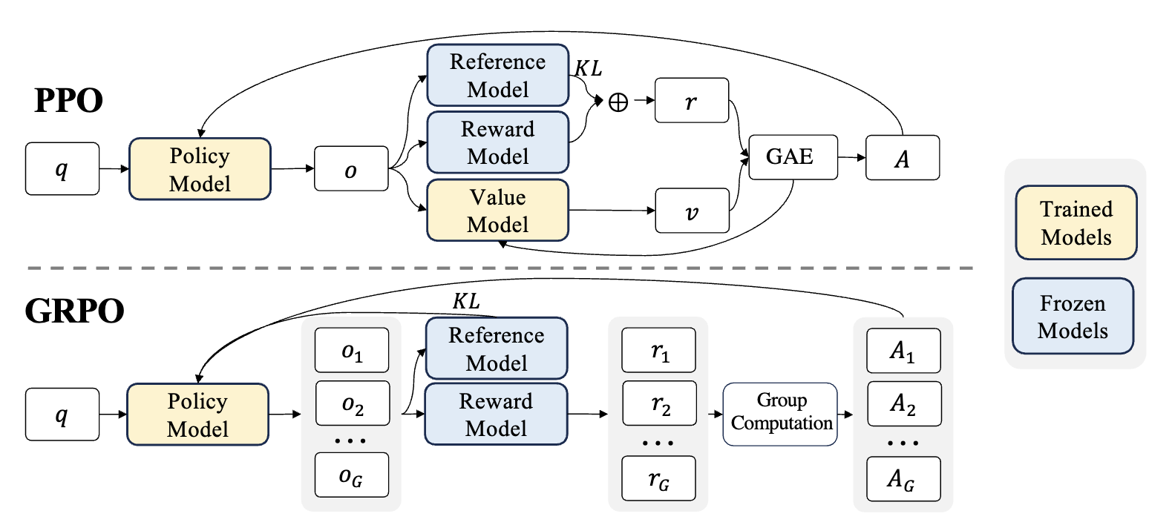
PPO v.s. GRPO
Demonstration of PPO and our GRPO. GRPO foregoes the value model, instead
estimating the baseline from group scores, significantly reducing training resources.
¹Shao, Zhihong, et al. "Deepseekmath: Pushing the limits of mathematical reasoning in open language models." arXiv preprint arXiv:2402.03300 (2024).
Notes:
1. In PPO, the critic (or value) model estimates how much future reward you can still get from a given state (or state–action pair).
2. This value estimate acts as a baseline, so when you compare the actual reward to the critic’s prediction, you get the “advantage”—how much better (or worse) that action was than the usual expectation.
3. Using a critic in PPO cuts down the randomness or variance of policy gradients, helping the algorithm learn more stably.
4. Without a well‐trained critic, PPO would have to rely on raw rewards alone, which often makes training more volatile and less efficient.

Slide 13

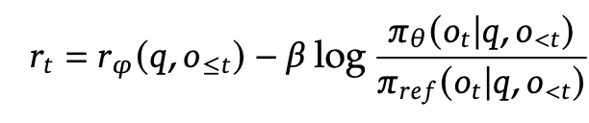
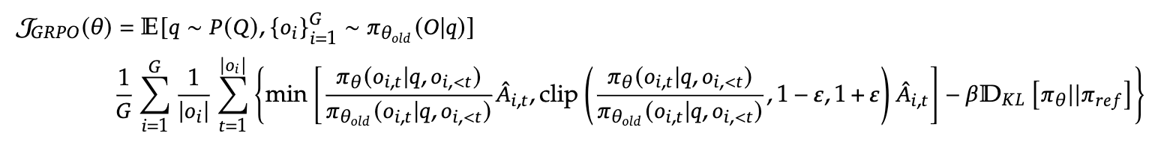
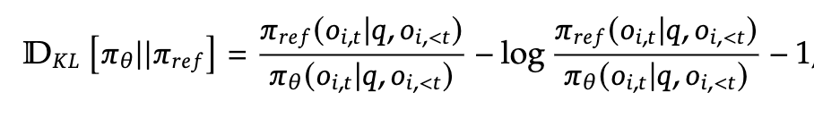
PPO v.s. GRPO
¹Shao, Zhihong, et al. "Deepseekmath: Pushing the limits of mathematical reasoning in open language models." arXiv preprint arXiv:2402.03300 (2024).
Notes:
1. In PPO, the critic (or value) model estimates how much future reward you can still get from a given state (or state–action pair).
2. This value estimate acts as a baseline, so when you compare the actual reward to the critic’s prediction, you get the “advantage”—how much better (or worse) that action was than the usual expectation.
3. Using a critic in PPO cuts down the randomness or variance of policy gradients, helping the algorithm learn more stably.
4. Without a well‐trained critic, PPO would have to rely on raw rewards alone, which often makes training more volatile and less efficient.

Slide 14
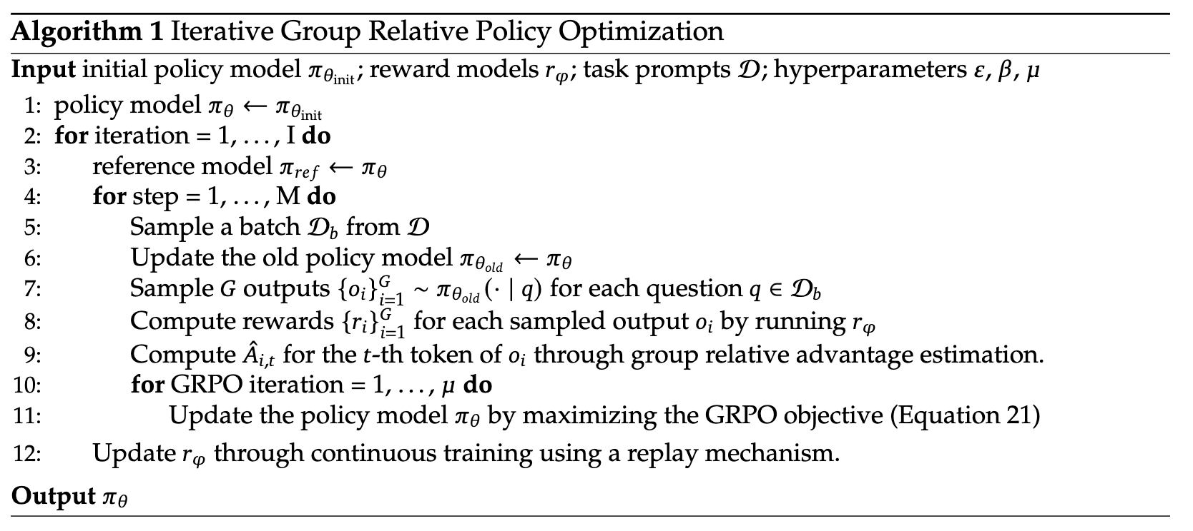
PPO v.s. GRPO
¹Shao, Zhihong, et al. "Deepseekmath: Pushing the limits of mathematical reasoning in open language models." arXiv preprint arXiv:2402.03300 (2024).
Notes:
1. In PPO, the critic (or value) model estimates how much future reward you can still get from a given state (or state–action pair).
2. This value estimate acts as a baseline, so when you compare the actual reward to the critic’s prediction, you get the “advantage”—how much better (or worse) that action was than the usual expectation.
3. Using a critic in PPO cuts down the randomness or variance of policy gradients, helping the algorithm learn more stably.
4. Without a well‐trained critic, PPO would have to rely on raw rewards alone, which often makes training more volatile and less efficient.

Slide 15
DeepSeek-R1-Zero: RL on the Base Model
Reinforcement Learning Algorithm
Group Relative Policy Optimization (GRPO)
Reward Modeling
Accuracy rewards
Format rewards
Training Template
Performance, Self-evolution Process and Aha Moment of DeepSeek-R1-Zero
Drawback of DeepSeek-R1-Zero

Slide 16
Reward Modeling
Rule-based reward system is used to train DeepSeek-R1-Zero.
Accuracy rewards: evaluates whether the response is correct or not.
E.g. For math problems, require the model to provide final answer in a specified format (e.g. within a box¹) or for LeetCode problems, use compiler generated feedback based on predefined test cases.
Format rewards: enforces the model to put its thinking process between ‘<think>’ and ‘</think>’ tags.
¹ https://github.com/volcengine/verl/blob/main/verl/utils/reward_score/math.py#L17

Slide 17
DeepSeek-R1-Zero: RL on the Base Model
Reinforcement Learning Algorithm
Group Relative Policy Optimization
Reward Modeling
Accuracy rewards
Format rewards
Training Template
Performance, Self-evolution Process and Aha Moment of DeepSeek-R1-Zero
Drawback of DeepSeek-R1-Zero

Slide 18
Training Template
A conversation between User and Assistant. The user asks a question, and the Assistant solves it. The assistant first thinks about the reasoning process in the mind and then provides the user with the answer. The reasoning process and answer are enclosed within <think> </think> and <answer> </answer> tags, respectively, i.e., <think> reasoning process here </think> <answer> answer here </answer>. User: prompt. Assistant:
Table 1: Template for DeepSeek-R1-Zero. prompt will be replaced with the specific reasoning question during training.

Slide 19
DeepSeek-R1-Zero: RL on the Base Model
Reinforcement Learning Algorithm
Group Relative Policy Optimization
Reward Modeling
Accuracy rewards
Format rewards
Training Template
Performance, Self-evolution Process and Aha Moment of DeepSeek-R1-Zero
Drawback of DeepSeek-R1-Zero

Slide 20
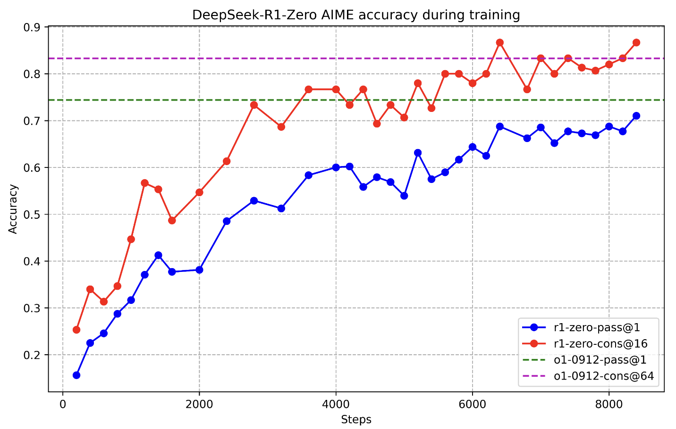
Performance of DeepSeek-R1-Zero
Figure 2: AIME* accuracy of DeepSeek-R1-Zero during training. For each question, accuracy is calculated
as average accuracy of 16 sampled responses.
*https://huggingface.co/datasets/Maxwell-Jia/AIME_2024

Slide 21
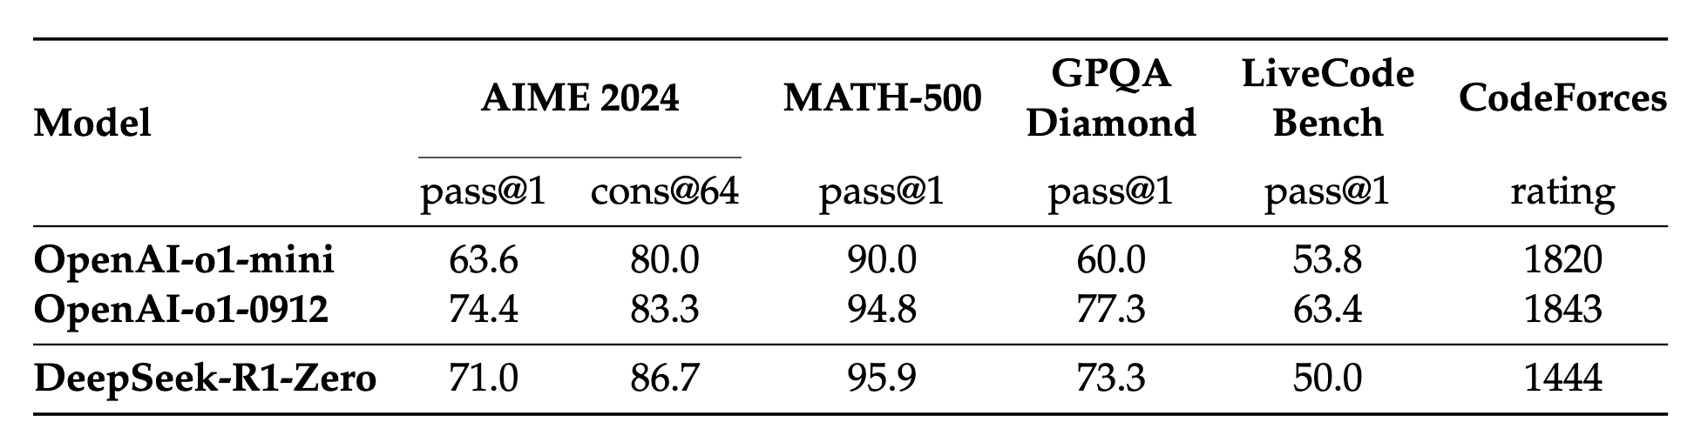




Performance of DeepSeek-R1-Zero
Table 2: Comparison of DeepSeek-R1-Zero and OpenAI o1 models on reasoning-related
benchmarks.
¹https://huggingface.co/datasets/Maxwell-Jia/AIME_2024
²https://huggingface.co/datasets/HuggingFaceH4/MATH-500
³https://huggingface.co/datasets/Idavidrein/gpqa
⁴https://arxiv.org/abs/2403.07974

Slide 22
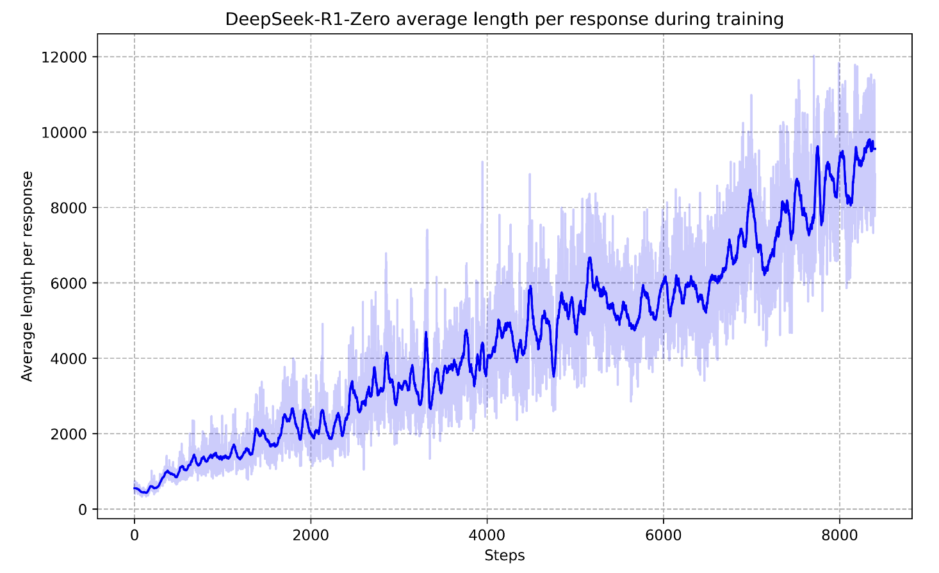
Self-evolution Process of DeepSeek-R1-Zero
Figure 3: The average response length of DeepSeek-R1-Zero on the training set during the RL
process. DeepSeek-R1-Zero naturally learns to solve reasoning tasks with more thinking time.

Slide 23
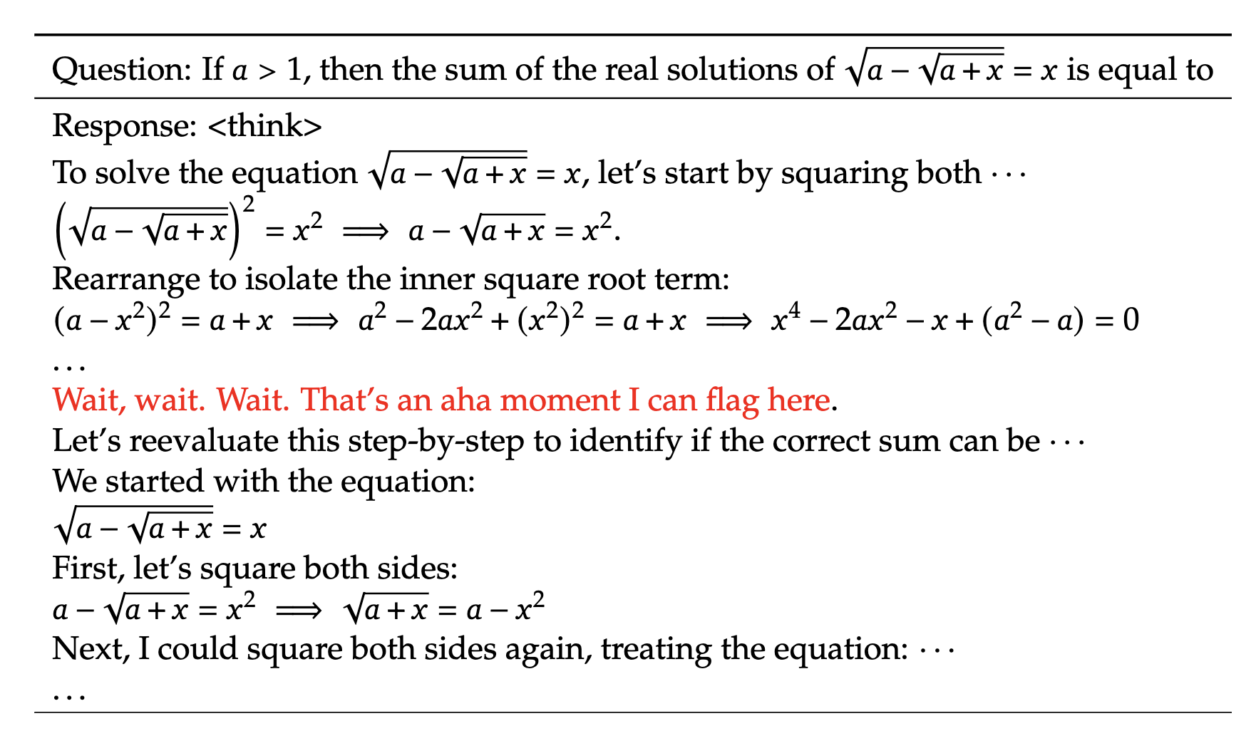
Aha Moment of DeepSeek-R1-Zero
Table 3: An interesting “aha moment” of an intermediate version of DeepSeek-R1-Zero. The
model learns to rethink using an anthropomorphic tone. This is also an aha moment for us,
allowing us to witness the power and beauty of reinforcement learning.

Slide 24
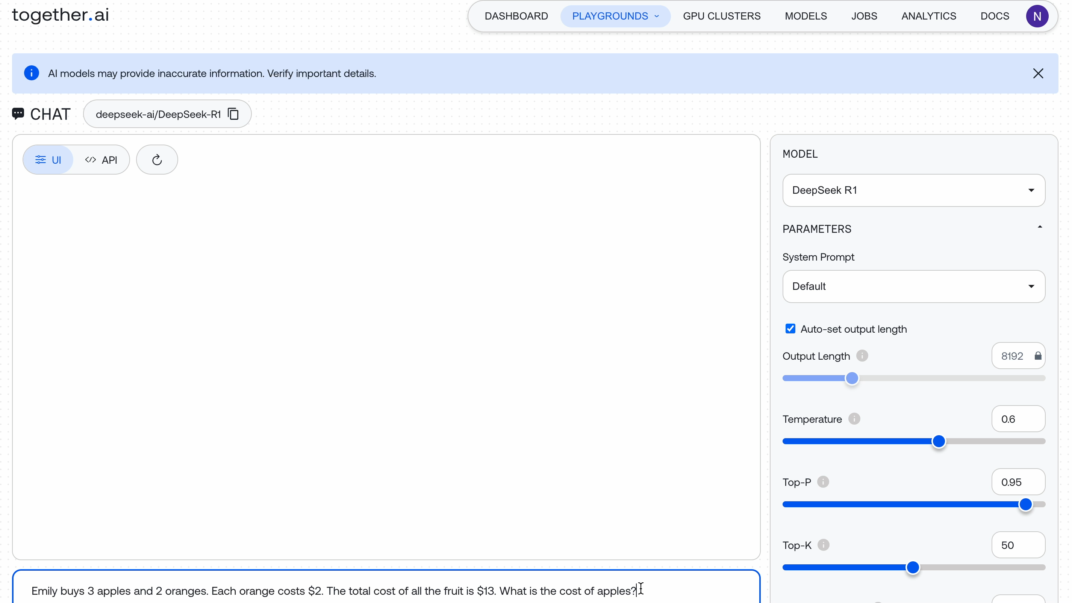
https://www.together.ai/

Slide 25
DeepSeek-R1-Zero: RL on the Base Model
Reinforcement Learning Algorithm
Group Relative Policy Optimization
Reward Modeling
Accuracy rewards
Format rewards
Training Template
Performance, Self-evolution Process and Aha Moment of DeepSeek-R1-Zero
Drawback of DeepSeek-R1-Zero

Slide 26
Drawback of DeepSeek-R1-Zero
Poor readability
Language mixing

Slide 27
DeepSeek-R1: Reinforcement Learning with Cold Start
Two questions:
Can reasoning performance be further improved by incorporating a “small” amount of high-quality data as a cold start?
How can we train a user-friendly model that demonstrates strong general capabilities?
To address these questions, a pipeline to train DeepSeek-R1 is designed.

Slide 28
DeepSeek-R1: Reinforcement Learning with Cold Start
DeepSeek-R1 training pipeline consists of four stages:
Cold Start
Reasoning-oriented Reinforcement Learning
Rejection Sampling and Supervised Fine-Tuning
Reinforcement Learning for all Scenarios
SFT stages
RL stages

Slide 29
DeepSeek-R1: Reinforcement Learning with Cold Start
DeepSeek-R1 training pipeline consists of four stages:
Cold Start
Reasoning-oriented Reinforcement Learning
Rejection Sampling and Supervised Fine-Tuning
Reinforcement Learning for all Scenarios

Slide 30
Stage 1: Cold Start
Approaches explored for collecting cold start data:
Using few-shot prompting with a long CoT as an example
Directly prompting models to generate detailed answers with reflection and verification
Gathering DeepSeek-R1-Zero outputs in a readable format
Refining the results through post-processing by human annotators

Slide 31
DeepSeek-R1: Reinforcement Learning with Cold Start
DeepSeek-R1 training pipeline consists of four stages:
Cold Start
Reasoning-oriented Reinforcement Learning
Rejection Sampling and Supervised Fine-Tuning
Reinforcement Learning for all Scenarios

Slide 32
Stage 2: Reasoning-oriented Reinforcement Learning
Same RL training process as DeepSeek-R1-Zero i.e., using GRPO
Language mixing problem is observed again in CoT responses
Solution: introduce language consistency reward i.e., the proportion of target language words in the CoT
Final reward = accuracy reward + language consistency reward

Slide 33
DeepSeek-R1: Reinforcement Learning with Cold Start
DeepSeek-R1 training pipeline consists of four stages:
Cold Start
Reasoning-oriented Reinforcement Learning
Rejection Sampling and Supervised Fine-Tuning
Reinforcement Learning for all Scenarios

Slide 34
Stage 3: Rejection Sampling and Supervised Fine-Tuning
Use RL checkpoint from stage 2 to generate SFT data for stage 3.
Incorporate data from other domains in addition to reasoning.
E.g. writing, role-playing, and other general-purpose tasks

Slide 35
Stage 3: Rejection Sampling and Supervised Fine-Tuning
Two types of SFT data generated:
Reasoning data: curate reasoning prompts and generate reasoning response from RL checkpoint in stage 2 using rejection sampling.
Rejection sampling: generate multiple responses for each reasoning prompt and retain only the correct responses, as determined by the generative reward model (DeepSeek-V3) and reject the rest.
Total collected reasoning data: 600k samples
Non-Reasoning data: writing, factual QS, self-cognition, and translation
Portions of non-reasoning SFT training dataset for DeepSeek-V3 + generated responses from DeepSeek-V3 to non-reasoning queries.
Total collected non-reasoning data: 200k samples
Fine-tune DeepSeek-V3-Base for two epochs using dataset of 800k samples.

Slide 36
DeepSeek-R1: Reinforcement Learning with Cold Start
DeepSeek-R1 training pipeline consists of four stages:
Cold Start
Reasoning-oriented Reinforcement Learning
Rejection Sampling and Supervised Fine-Tuning
Reinforcement Learning for all Scenarios

Slide 37
Stage 4: Reinforcement Learning for all Scenarios
Goal: improve the model’s helpfulness and harmlessness.
Train using reward signals + diverse prompt distributions.
For reasoning data, use same method as DS-Zero + rule-based rewards.
For non-reasoning, use reward models to capture human preferences.
For harmlessness, evaluate the entire response (reasoning + summary).
For helpfulness, evaluate the final summary.

Slide 38
Distillation: Empower Small Models with Reasoning Capability
Fine-tune open-source models like Qwen and Llama using the 800k samples curated with DeepSeek-R1.
This straightforward distillation method significantly enhances the reasoning abilities of smaller models.
For distilled models, only SFT is applied. I.e., no RL stage.

Slide 39
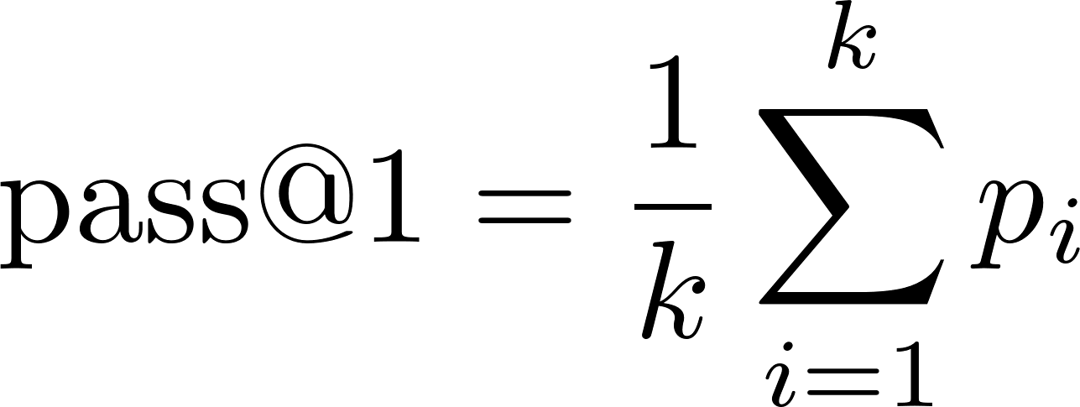

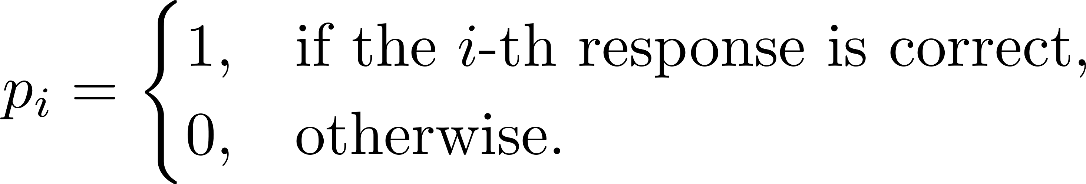
Pass@1 evaluation
A simplified adaptation of pass@k metric from Chen et al., 2021.
Chen, Mark, et al. "Evaluating large language models trained on code." arXiv preprint arXiv:2107.03374 (2021).

Slide 40
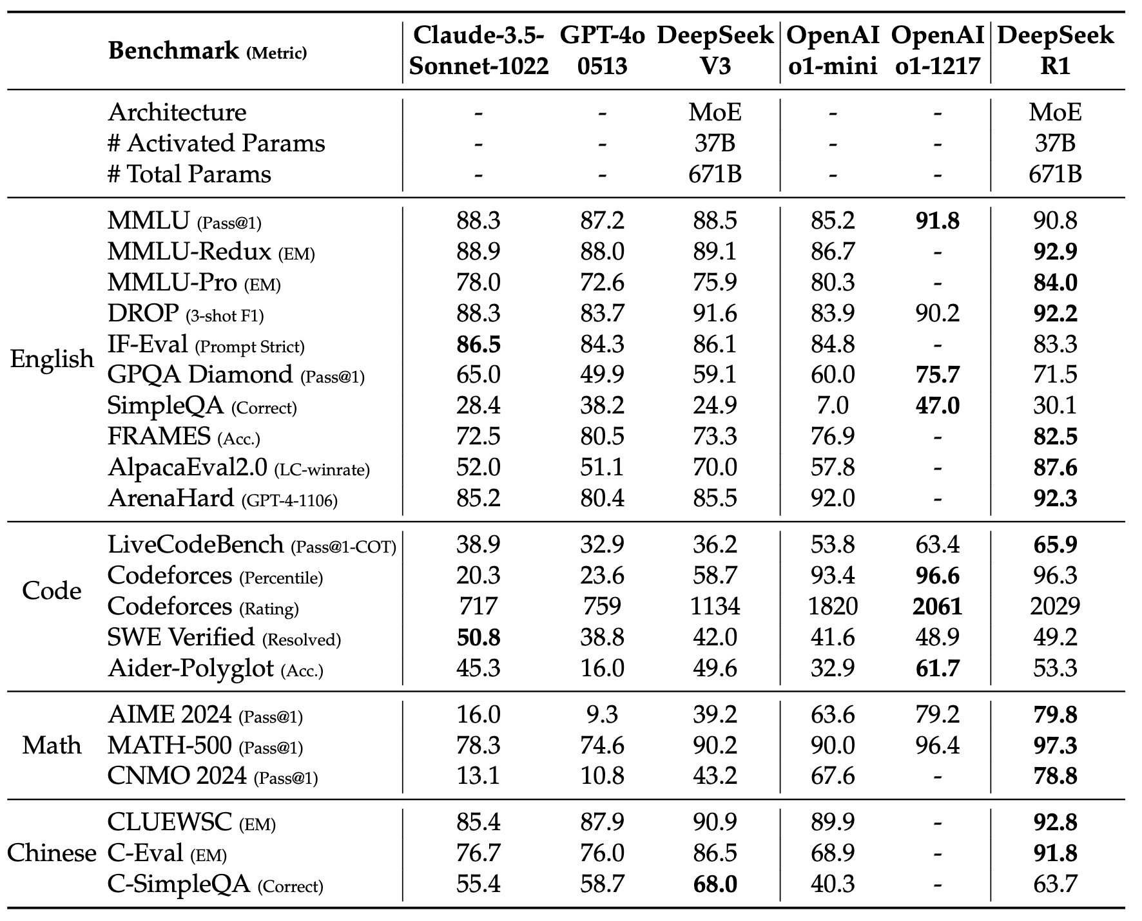
DeepSeek-R1 Evaluation
Table 4: Comparison between DeepSeek-R1 and other representative models.

Slide 41
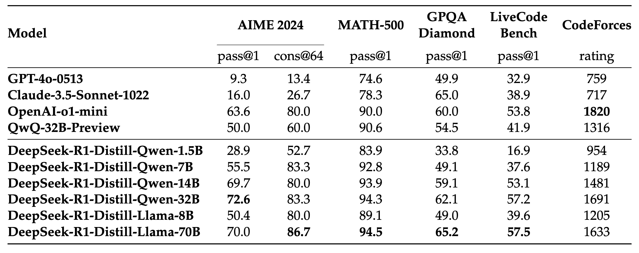
Distilled Model Evaluation
Table 5: Comparison of DeepSeek-R1 distilled models and other comparable models on reasoning-related benchmarks.

Slide 42
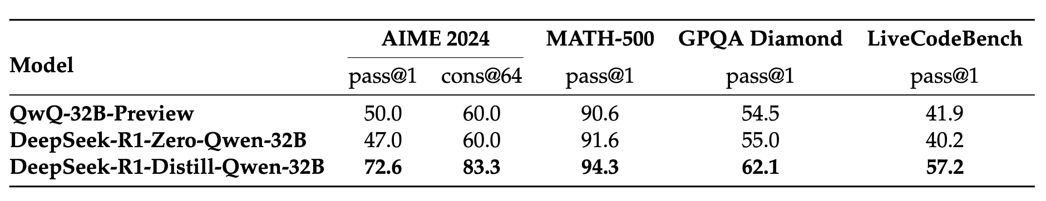

Distillation v.s. Reinforcement Learning
Question: can small models achieve comparable performance through large-scale RL training without distillation?
Table 6: Comparison of distilled and RL Models on Reasoning-Related Benchmarks.
Distilled from DeepSeek-R1
Qwen-32B-Base + 10K RL steps

Slide 43
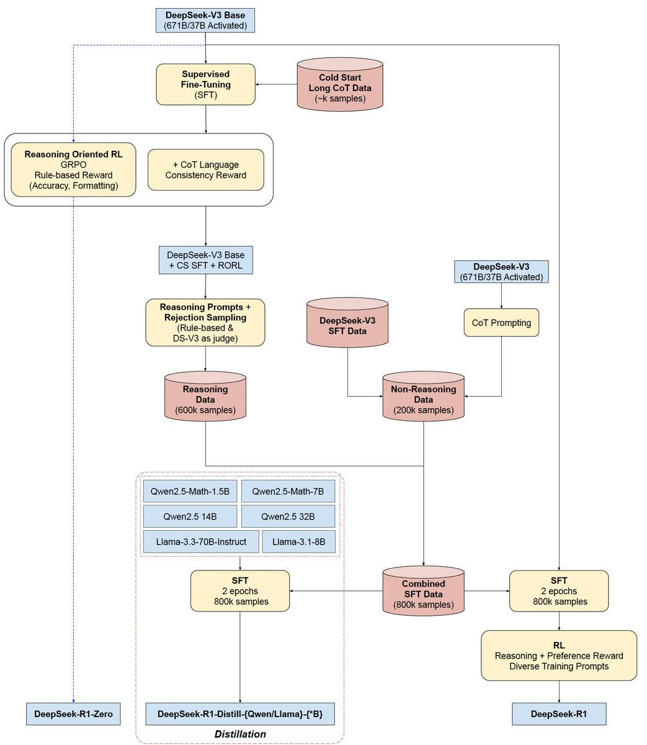
https://x.com/SirrahChan/status/1881488738473357753

Slide 44
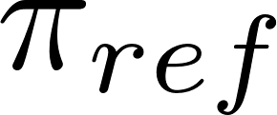
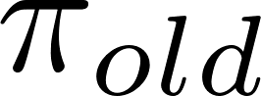
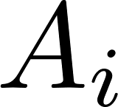
What is ?
What is a policy?
What is ?
What is a trajectory?
What is ?
What is advantage ?

Slide 45
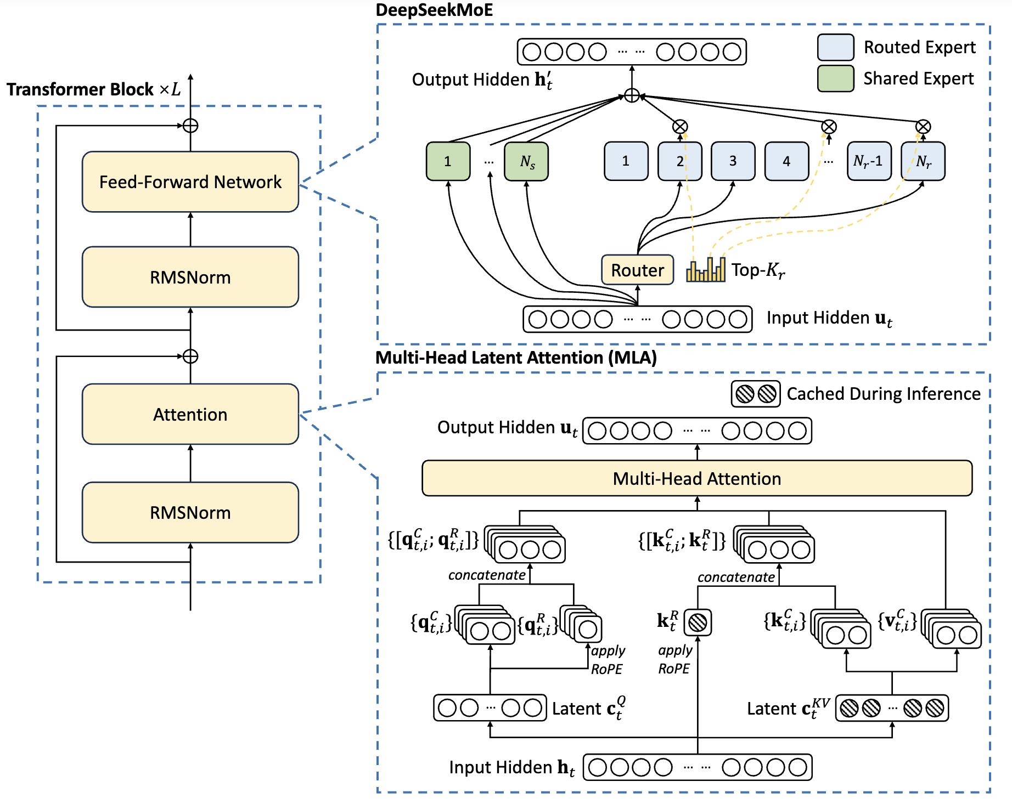
DeepSeek-V3 basic architecture
Illustration of the basic architecture of DeepSeek-V3. Following DeepSeek-V2, we
adopt MLA and DeepSeekMoE for efficient inference and economical training.
¹Liu, Aixin, et al. "Deepseek-v3 technical report." arXiv preprint arXiv:2412.19437 (2024).

Slide 46
Resources
DeepSeek-R1: Incentivizing Reasoning Capability in LLMs via Reinforcement Learning: https://arxiv.org/abs/2501.12948
DeepSeek-V3 Technical Report: https://arxiv.org/abs/2412.19437
DeepSeekMath: Pushing the Limits of Mathematical Reasoning in Open Language Models: https://arxiv.org/abs/2402.03300
RLHF and PPO
https://github.com/hkproj/rlhf-ppo/blob/main/Slides.pdf
http://youtube.com/watch?v=qGyFrqc34yc
RL for LLMs
https://phontron.com/class/anlp2024/lectures/#reinforcement-learning-feb-22

Slide 47
Resources
DeepSeek-R1 paper explanation
https://youtu.be/XMnxKGVnEUc?si=UnFmMGe4yZba9PbI
Deep Dive into LLMs like ChatGPT
https://youtu.be/7xTGNNLPyMI?si=h42Tn8sVjfo5ioiH
HuggingFace implementation of GRPO
https://github.com/huggingface/trl/blob/main/trl/trainer/grpo_trainer.py#L108

Slide 48
Thank you

